Slide 1
Introduction to R for Life Sciences
João Lourenço, Tania Wyss & Nadine Fournier
Translational Data Science – Facility
SIB Swiss Institute of Bioinformatics
With slides from Diana Marek, Thomas Junier, Wandrille Duchemin, Leonore Wigger
From: First steps with R in Life Sciences

Slide 2
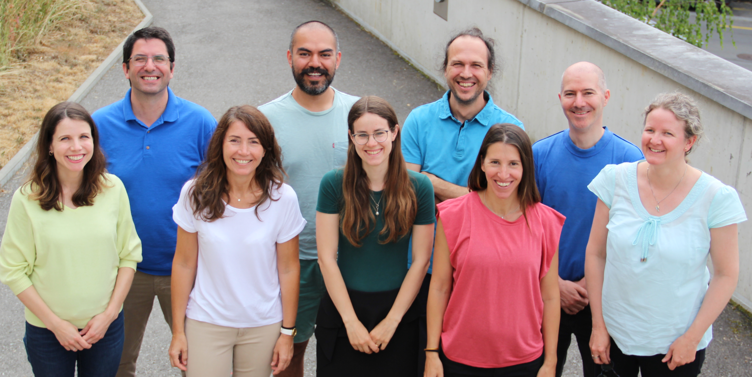
The Translational Data Science Facility
Part of the SIB Swiss Institute of Bioinformatics
Located at the AGORA Cancer Research Center in Lausanne
Provides statistics, bioinformatics and computational expertise to molecular biology and applied research labs.
Participates in fundamental and translational research by providing expertise in data analysis of single-cell and bulk multi-omics, spatial transcriptomics, flow cytometry, etc
For core facility service inquiry: nadine.fournier@sib.swiss
https://agora-cancer.ch/scientific-platforms/translational-data-science-facility/
https://www.sib.swiss/raphael-gottardo-group
Notes:
The Translational Data Science (TDS) group focuses on developing novel computational tools, statistical methods and machine learning algorithms for the analysis of high-throughput and high-dimensional datasets generated by novel assay technologies with applications in immunology, vaccine research and immunotherapy. We collaborate with multiple research groups locally, nationally and internationally to address important immunological problems through high-dimensional modeling and data integration.

Slide 3
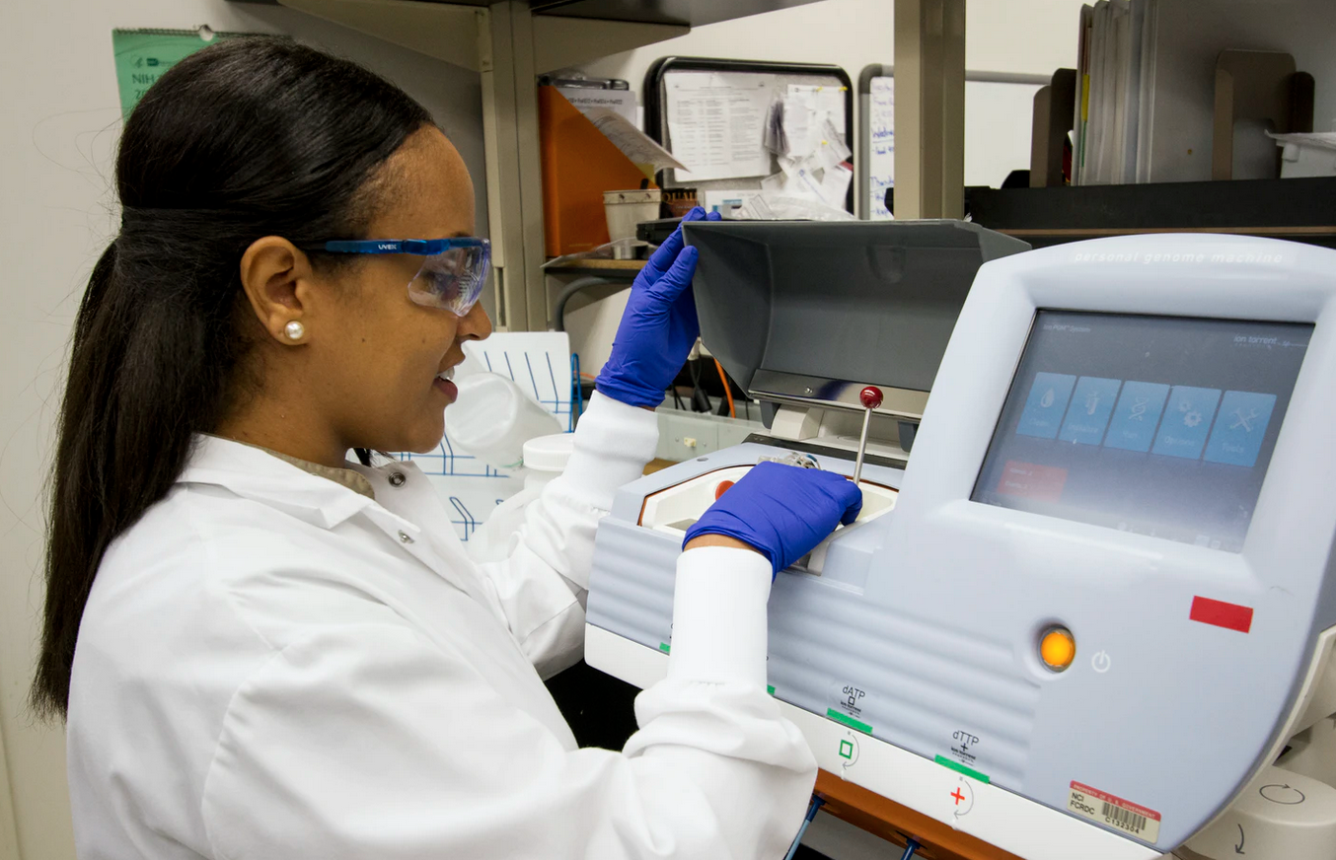

Tell us about yourself !
Share about yourself and your research, experience with programming, etc
Photo by National Cancer Institute, Unsplash
Photo by Scott Graham, Unsplash

Slide 4
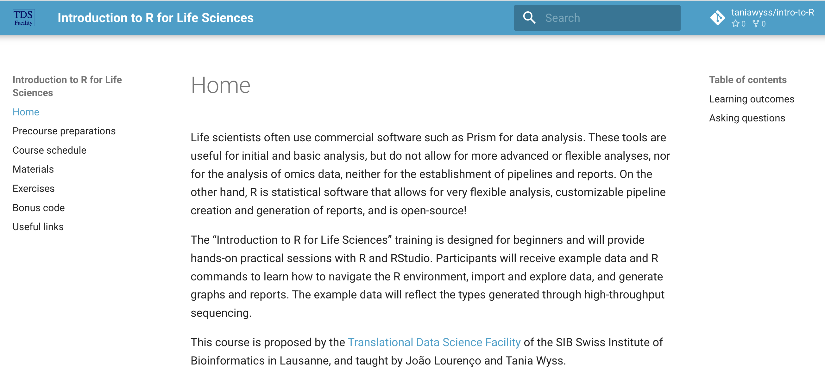
Course material
1. Website
https://taniawyss.github.io/intro-to-R/
2. Ask us questions!

Slide 5




Outline & Schedule
Morning
01
Introduction to R and the RStudio environment, working with scripts files
Exercises
(9:00 – 10:30)
10:30 – 10:50 Coffee break
02
Syntax, data types and structures, importing data
Exercises
(10:50 -12:00)
12:00 – 13:00 Lunch break

Slide 6


Outline & Schedule
Afternoon
03
Graphics
Exercises
(13:00 – 15:30)
15:30 -15:50 Coffee break
04
04
Statistics
Exercises
(15:50 – 16:50)
16:50 - 17:00 Feedback and end of day

Slide 7

Course Content
R is vast and can't be learned in one day. The scope of this course is to:
Give you a basic understanding of concepts behind R
Allow you to import and manipulate data in R
Show you how to create your first plots
This course is only the first step in your journey!

Slide 8

01
Introduction to R and the RStudio environment

Slide 9
What is R ?
R is a programming language and an environment for statistical computation and graphics.
A simple development environment with a console and a text editor
Facilities for data import, manipulation and storage
Functions for calculations on vectors and matrices
Large collections of data analysis tools
Graphical tools
https://www.r-project.org/
Notes:
Open the R page https://www.r-project.org/ and highlight some aspects
What is R:
Language and environment for statistical computing and graphics
Free (GNU General Public License)
It compiles and runs on a wide variety of platforms (including Linux, Windows and MacOS).
Wide variety of data analysis and graphical techniques
It is highly extensible (open source - large community - anyone can contribute with add-on packages for additional functionalities - thousands of packages available -> Wide variety of tools for data analysis
The basic R installation is maintained by a group of core developers - upgrades every 6 months

Slide 10
Taking Advantage of R For Your Work
Data analysis in R
Planning and Preparation
Export
Data Representation (plots, tables)
Communicate
(reports)
Data acquisition
Exploration
Results
Preprocessing
(formatting, cleaning, QC)
Analysis
(statistics,
omics
analysis, etc )
Manual analysis
(QC, gating)
Import
Notes:
Planning and preparation:
Scientific question
Power analysis
Panel design
Data acquisition
Fow cytometry data (﻿.fcs file)
Clinical data, panel and other (excel, text )
Manual analysis (FlowJo)
Quality control
Gating
Preprocessing:
Data formating, tidying up, cleaning, data manipulation (transformation)
Assessment of data quality (Quality control)
Data exploration (plots, tables with summaries, etc…)
Data representation:
Dimensionality reduction (PCA, UMAP tsne)
Analysis:
Clustering
Phenotype annotation / discovery
Hypothesis testing (differential abundance analysis, differential state analysis
Other statistical analysis (clinical data)

Slide 11
R's user community
Group of core developers who maintain and upgrade the basic R installation. New version every 6 months.
Anyone can contribute with add-on packages which provide additional functionality (thousands of such packages available) and help for each function.
Online help
in user group forums, eg:
https://stat.ethz.ch/mailman/listinfo/r-help http://stackoverflow.com/questions/tagged/r
in countless online tutorials, books, blogs
17

Slide 12

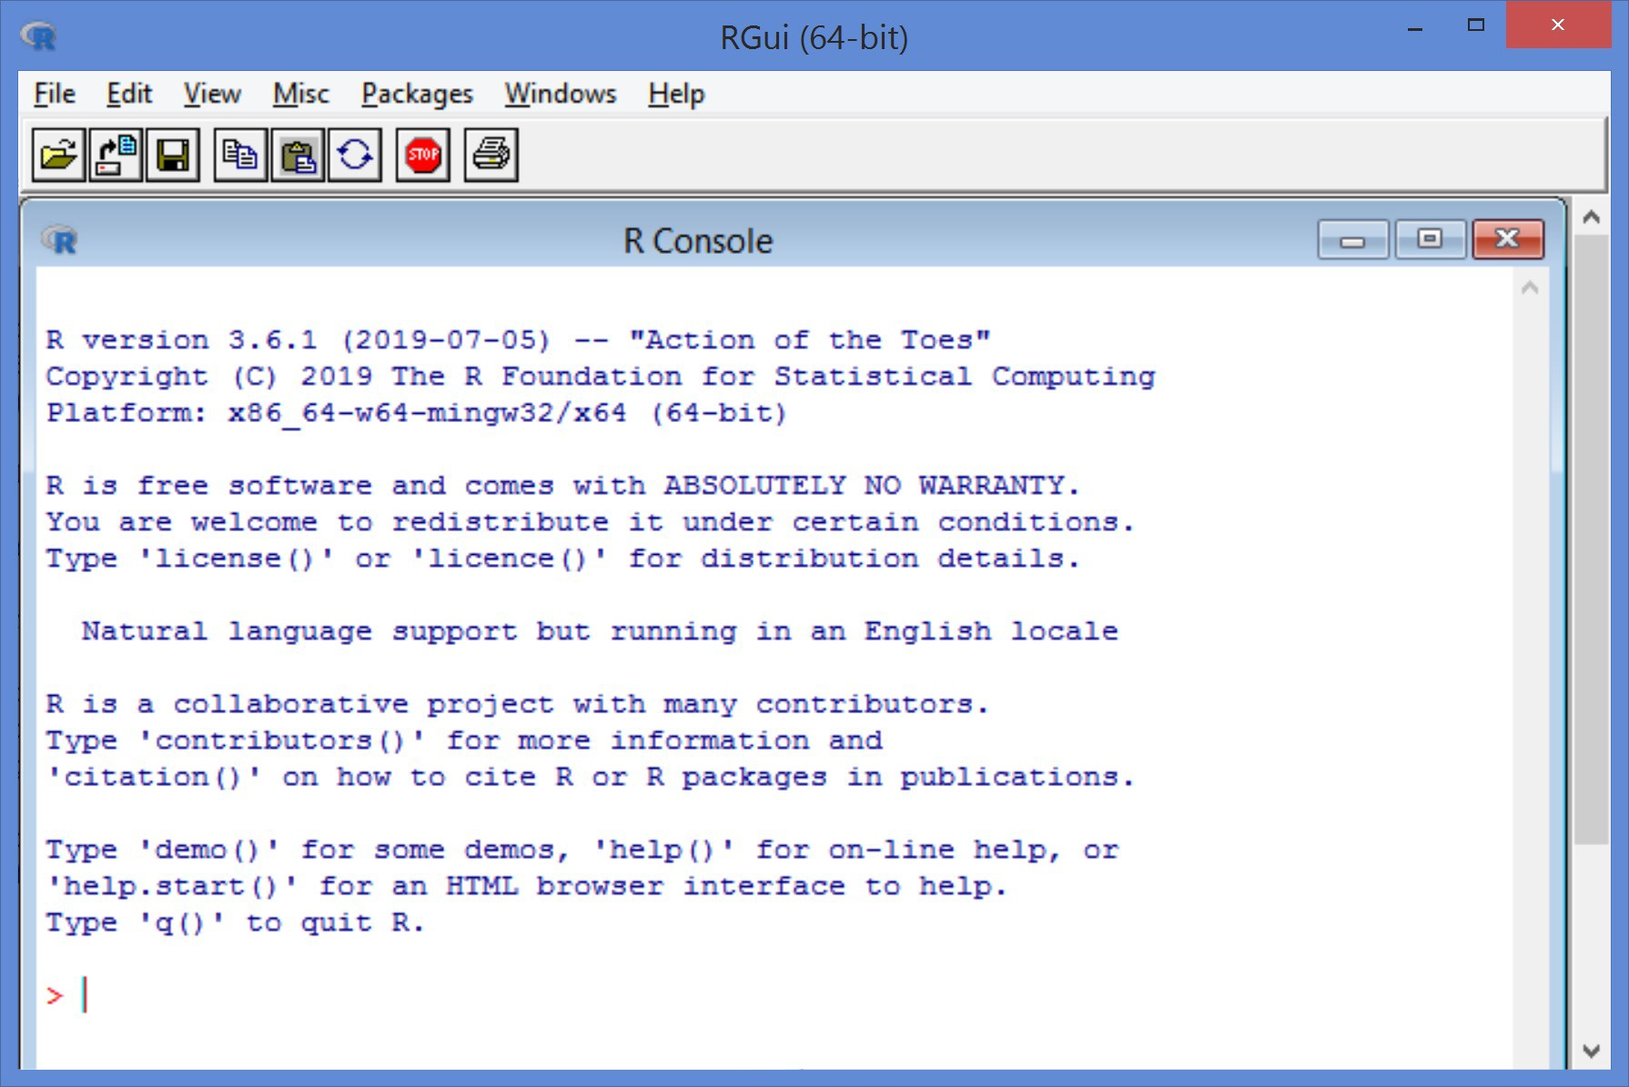
RGui (R Graphical user interface)
Together with the programming language, a (minimal) graphical user interface is installed.
Notes:
Standard interface you get when launching R
Simple interface:
menus and toolbars (limited to housekeeping tasks)
a console window

Slide 13

R Combined with RStudio
https://posit.co/products/open-source/rstudio/
RStudio is an integrated development environment (IDE), designed to help you be more productive with R
It includes:
A console
A syntax-highlighting editor that supports direct code execution
Tools for viewing the workspace and the history
A file explorer, a package explorer, plot and help display areas
We suggest RStudio as a more powerful, more comfortable alternative to the RGUI
Notes:
An integrated development environment (IDE) is a software application that helps programmers develop software code efficiently. It increases developer productivity by combining capabilities such as software editing, building, testing, and packaging in an easy-to-use application.

Slide 14
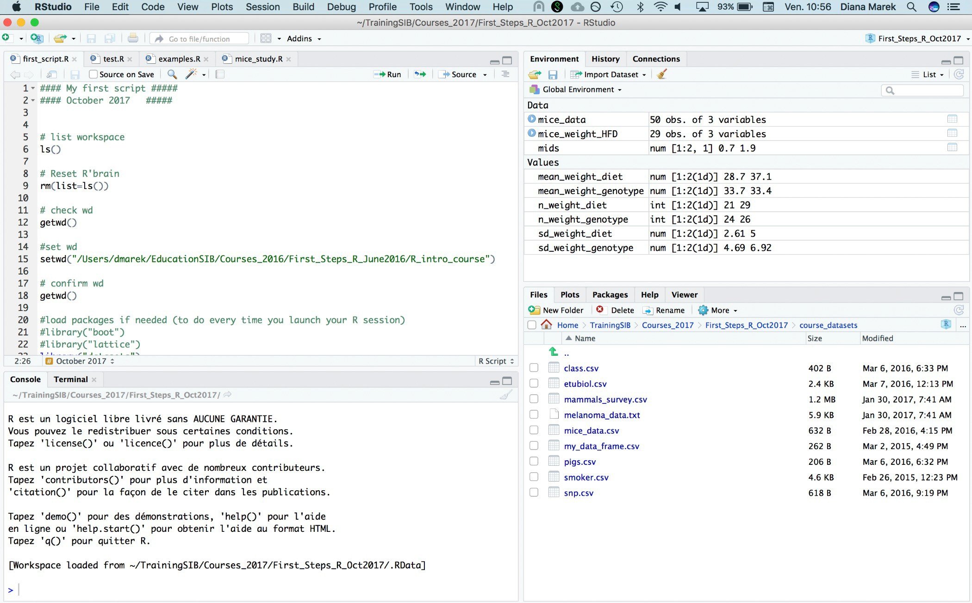
RStudio interface
Workspace
(Environment and History)
Editor (scripts)
Console
(or terminal)
File explorer, plots, packages, help
Notes:
Four main panels:
Console (or terminal)
Editor (scripts)
Workspace (Environment and History)
File explorer (source documents) / Plots / Packages / Help

Slide 15
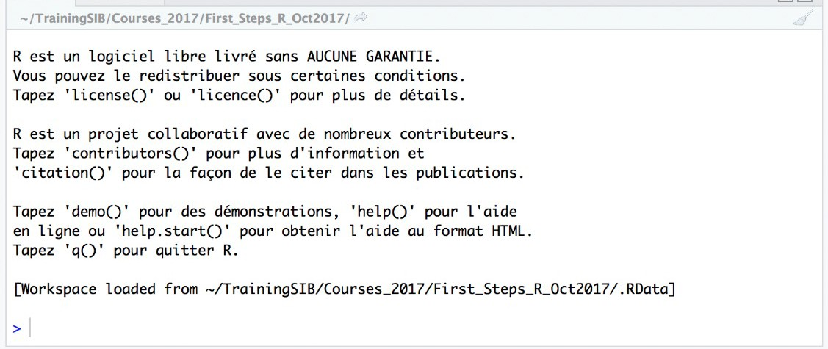
Console: The Command Line
The prompt ">" indicates that R is waiting for you to type a command
Notes:
Programming consists in giving orders (commands) for particular tasks to be performed.
Your code consists of a set of commands to be executed in succession.
There are two ways of executing code: either directly in the console or by using scripts
In the console, commands are executed by typing them after the prompt (>) and hiting the return key (eg: > 2 + 3 )

Slide 16
Try it out...
Type the following at the command prompt:
Simple calculations
> 1 + 1
Assign values to a variable names
> x <- 128.5
Display content of variables
> x
Pre-defined functions
> abs(-11)
The (not always helpful) help pages:
> ?p.adjust
Note the assignment operator <- with which we can keep values in the memory, by assigning a value and a name to a variable and store it in the session's memory.
We can use either <- or = to assign values to an object
Stick to one for consistency.
After each command, hit the return key.
This causes R to execute it.
Notes:
In the console at the prompt (">")
# type the following commands followed by the "Enter" key after each one to view
# the output printed on the console.
# R is a calculator:
1 + 1
x <- 128.5
# The variable that we named "x" and that contains the value 128.5 is created and listed and
# stored in the Environment/Workspace (top right window in RStudio).
# If you call the variable's name, the value stored within the "x" variable is
# printed in the console.
x
# The next command, with the use of the abs() function, prints the absolute value
# of -11 in the console.
abs(-11)
# Finally, the next command opens the help page for the p.adjust function
# (bottom right "Help" window in RStudio). What does the p.adjust() function do?
?abs

Slide 17
02
Working with script files

Slide 18
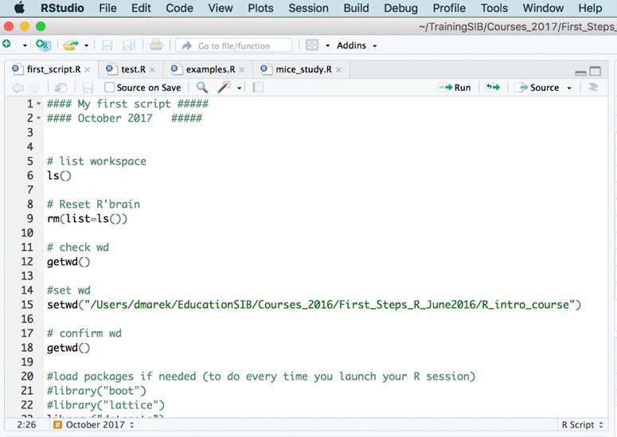
Editor: Write code to a script file
A script is a file that contains commands to be executed in succession.
Write your code into a script and save it
to have documentation later of what you did
to be able to re-use the code and create variations
for easy execution
Notice the syntax highlighting
Notes:
Although we usually use the console for testing commands, most of your code should be developed and saved in scripts
R scripts are text files containing code as a succession of commands to be executed
It is an efficient way to write, edit, execute and save your code

Slide 19
Create a new script and type code
Create a new script using File > New File > R script. Don't forget to save your script often.
By default, scripts are saved to the working directory.
Files can be saved to other locations (File -> Save As…)
Start Typing code at the top of the script
# My first command:
2 + 3
Notice the syntax highlighting
Comments : “#” at the beginning of a line or before a command: helping text ; everything that follows is ignored by the during executing ; R does not support multi-line comments

Slide 20
Send Code From a Script to the Console
Run individual lines, one by one:
In RStudio: put the cursor anywhere in a line, hit
Ctrl + enter (Windows)
Cmd + return (Mac)
or click the "Run" button
Tip: Run part of a line or multiple lines: Highlight the code, then proceed as above

Slide 21

Save, close and open scripts
Save a script: File > Save or
Close and open a script: File > Close and File > Open File
Tips:
Most of your code should be developed and saved in scripts.
You can execute individual lines of code interactively while you are writing it.
You can run the entire script once it is ready and debugged.

Slide 22
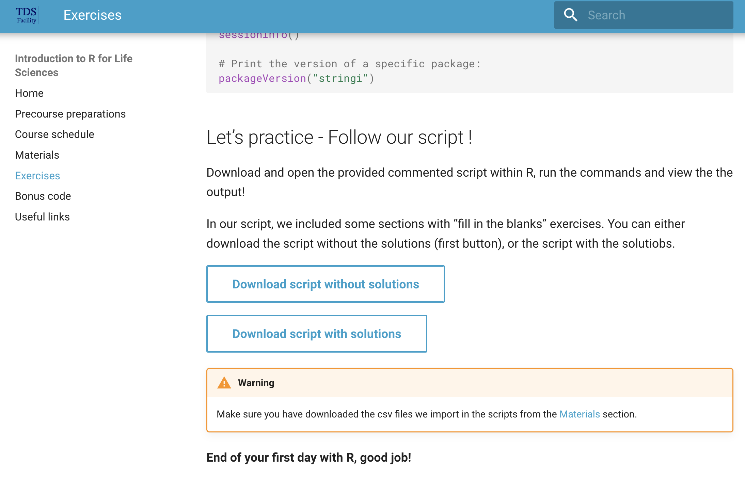
Let's work with the provided script!
Download it from the bottom of the Exercise page, and open it in R

Slide 23
02
Syntax, data types and structures, importing data

Slide 24
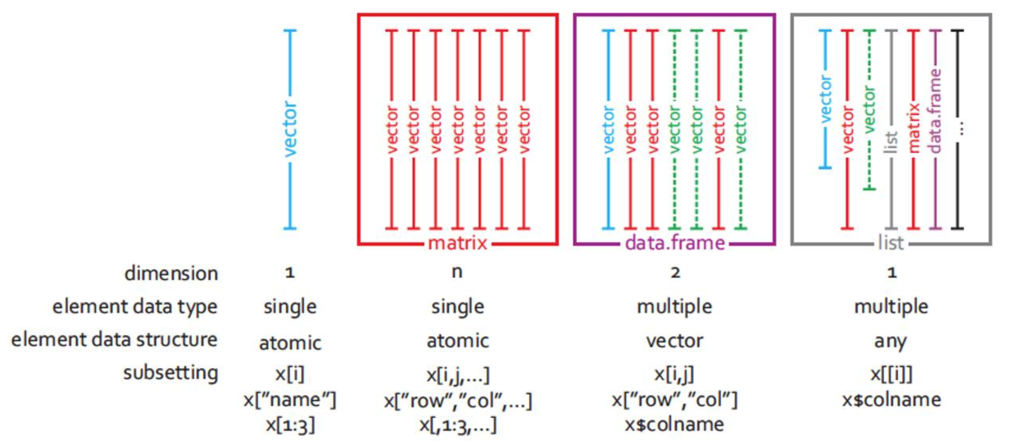
Common object classes
vector
matrix
data.frame
list

Slide 25
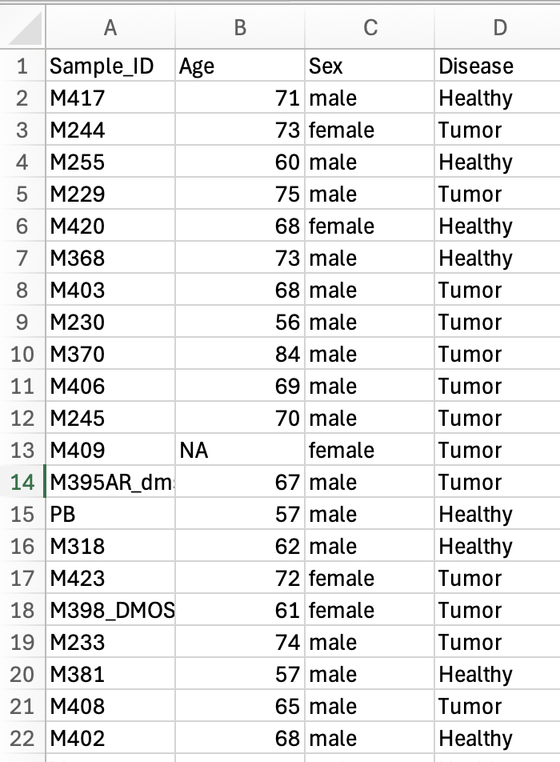
Example of a well-formated dataset
A header line with variable names (4 variables, 1 in each column)
No blank spaces in variable names (use _ instead)
Variable names do not contain symbols other than _
One observation per row
No comments or other content around the data table
Indicate missing values with NA
Example of a spreadsheet in Excel

Slide 26
03
Graphics

Slide 27
R graphics
R is powerful for plotting graphs and figures. Several plotting systems, including:
• base (i.e. graphics package, widely used, comes with basic R installation)
• ggplot2 (widely used in omics data analysis and others, implements the Grammar of Graphics (Wilkinson,
Springer (2005)))
They have very different syntaxes, cannot be mixed, and need to be learned separately.

Slide 28
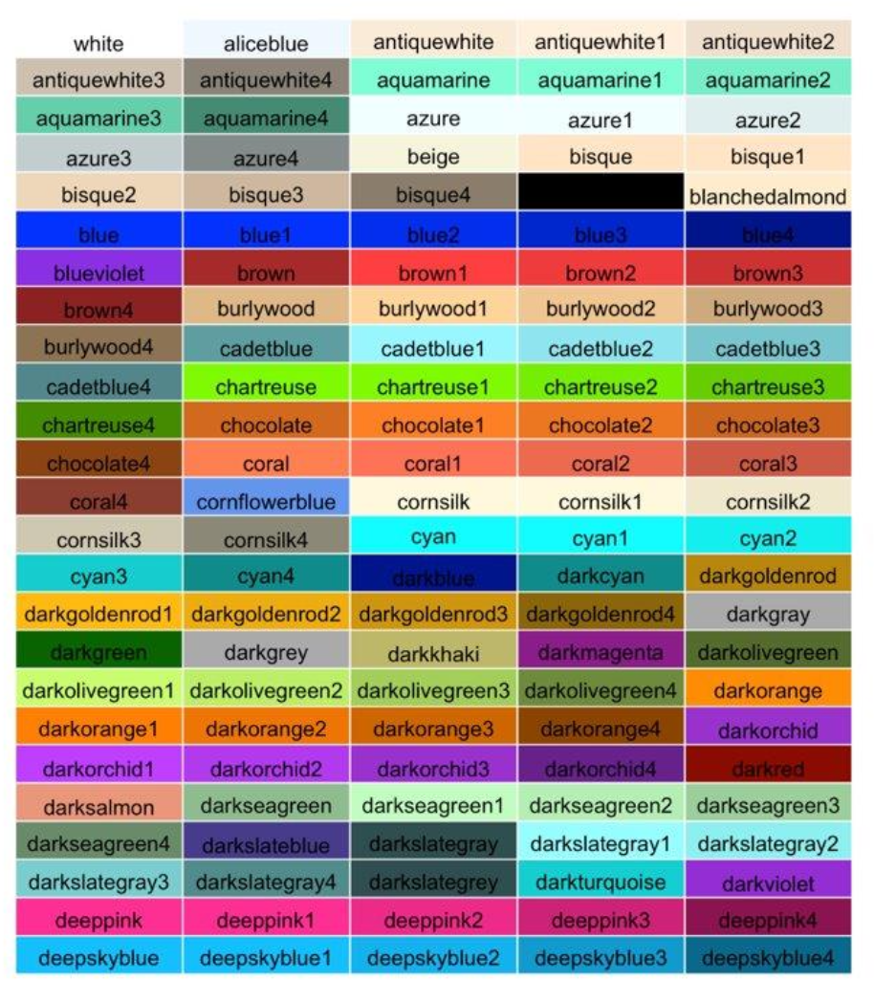
R colors (col)
657 built-in color names
Here is a subset -->
https://www.nceas.ucsb.edu/sites/default/files/2020-04/colorPaletteCheatsheet.pdf
http://www.stat.columbia.edu/~tzheng/files/Rcolor.pdf

Slide 29
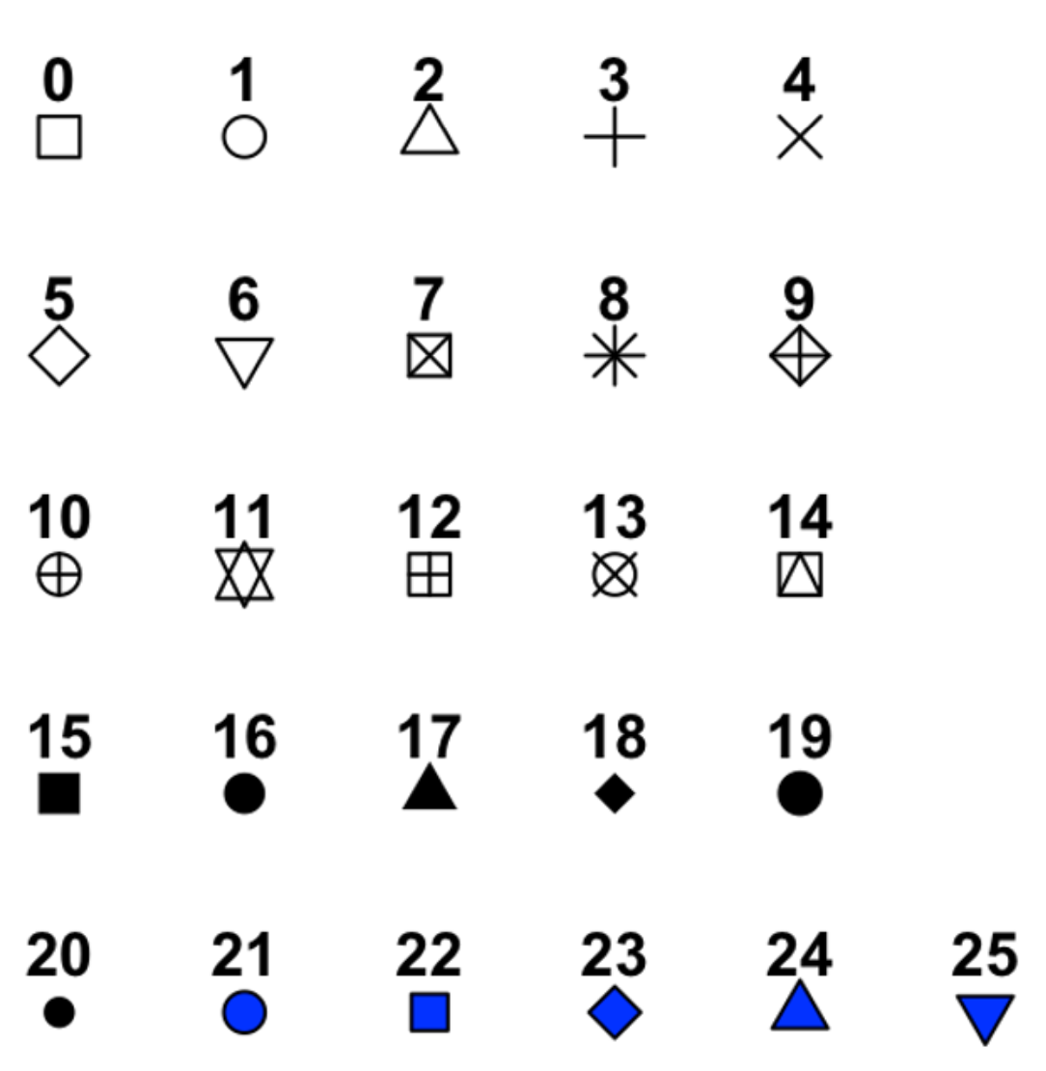
R plotting characters (pch)

Slide 30
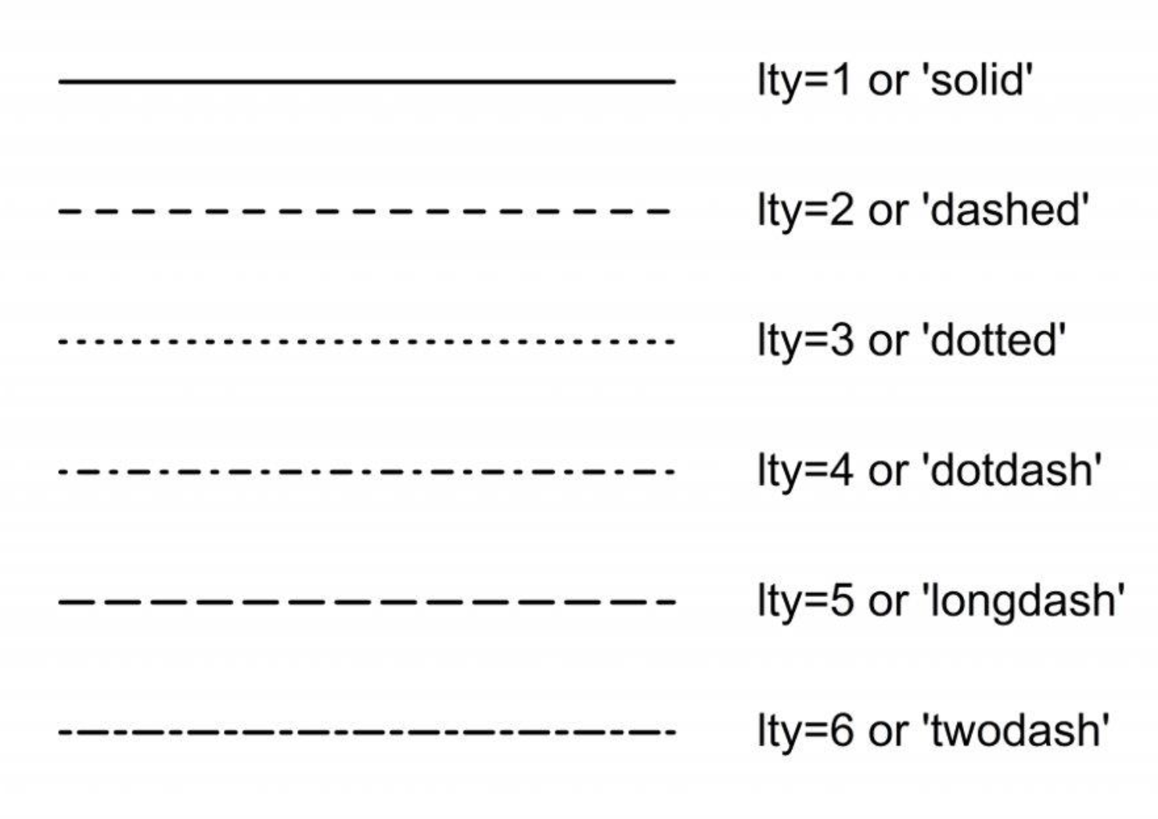
R line types (lty)

Slide 31
R base plotting system
Plots are built up step by step with multiple function calls.
High-level graphics functions:
Draw a new plot.
Tailor its appearance with optional arguments.
Low-level graphics functions: add graphical elements to an existing plot, piece by piece.

Slide 32
ggplot2

Slide 33
04
Basic Statistics in R

Slide 34
Statistical hypothesis testing
Two hypotheses in competition:
H0: the NULL hypothesis (usually the most conservative – e.g., “no difference”)
H1: the alternative hypothesis (usually the one we are actually interested in)
Example:
H0: « There is no difference in the expression of a gene between two given subtypes of melanoma»
H1: « The average expression of a gene is different in two given subtypes of melanoma»
Statistical test:
Calculate test statistic
Calculate associated p-value
Check if p-value is small enough to reject H0, according to pre-defined significance level

Slide 35
t-test
Goal:
Compare a continuous measure between two groups
Is the difference between the two group means statistically significant?
Assumptions:
Observations are independent
The two groups follow a normal distribution
Homogeneity of variances (R uses Welch's t-test, which does not assume equal variance)

Slide 36
Correlation
Measures the strength and direction of the relationship between two variables.
Correlation Coefficient (r):
Ranges from -1 to +1
Direction
Positive correlation (r>0): As one variable increases, the other tends to increase
Negative correlation (r < 0): As one variable increases, the other tends to decrease
Strength
Perfect correlation: |r| = 1
Strong correlation: 0.7 < |r| < 1
Moderate correlation: 0.3 < |r| ≤ 0.7
Weak correlation: 0 < |r| ≤ 0.3
No correlation (no consistent relationship between variables): r = 0
REMEMBER: Correlation does not imply causation !

Slide 37
Linear regression
Statistical method used to model the relationship between a dependent variable (Y) and one (or more) independent variable(s) (X).
Line of Best Fit: Y = β₀ + β₁X
β₀: Y-intercept (value of Y when X = 0)
β₁: Slope (change in Y for a one-unit increase in X)
Least Squares Method: Minimizes the sum of squared residuals
R-squared (R²):
Measures how well the model fits the data
Ranges from 0 to 1
Higher values indicate better fit

Slide 38

Additional learning and practicing
Wandrille Duchemin's First Steps with R in Life Sciences (2 days):
It includes more on statistics!
https://github.com/sib-swiss/first-steps-with-R-training/tree/master
Introduction to statistics with R (3 days), for R beginners also:
https://sib-swiss.github.io/Introduction-to-statistics-with-R/day1/
Introduction to R for Cancer Scientists
https://bioinformatics-core-shared-training.github.io/r-intro/index.html
Glittr.org

